Slide 1
Software Tools for Behavior Assessment
Justas Birgiolas & Chris Jernigan

Slide 2
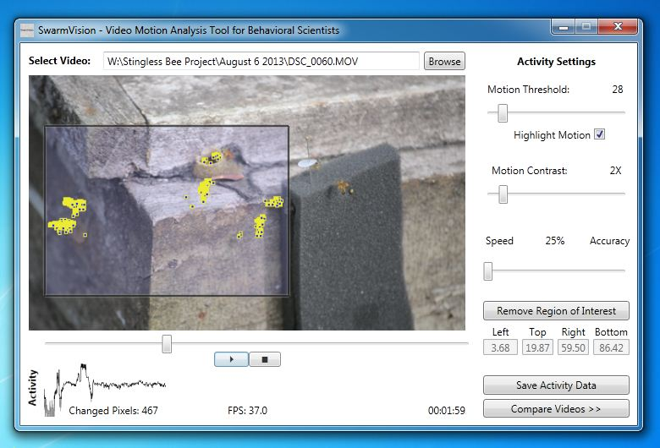
SwarmSight Motion Analysis

Slide 3
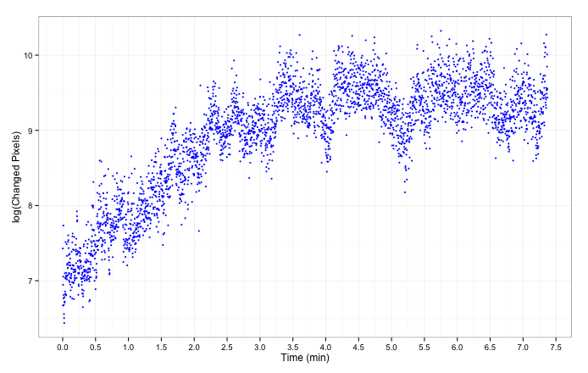
Assess Response Over Time

Slide 4
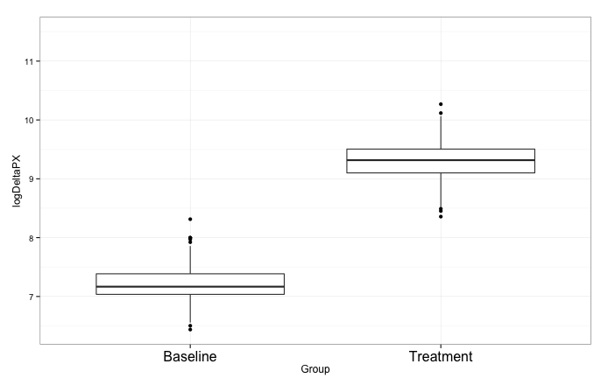
Compare Baseline To Treatment
***

Slide 5
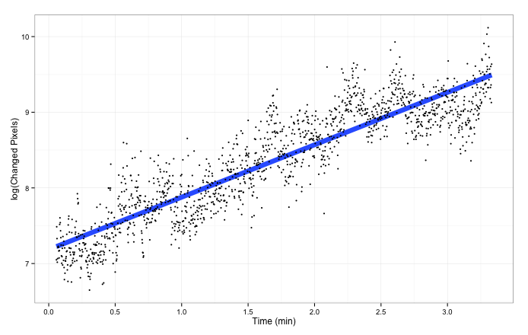
Regress and Correlate
Regression:
Slope = 0.69 ***
R² = 0.81
Correlation:
Spearman r = 0.89
Pearson r = 0.90

Slide 6
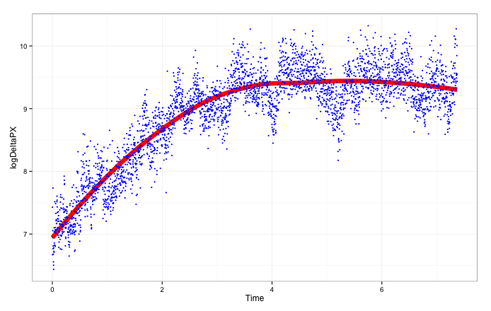
Extract Signal Trends

Slide 7
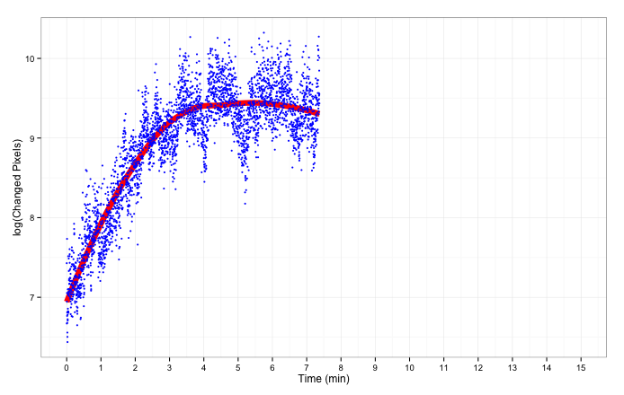
Assess the Full Cycle
Peak
?
Time to Peak
Time to Recovery

Slide 8
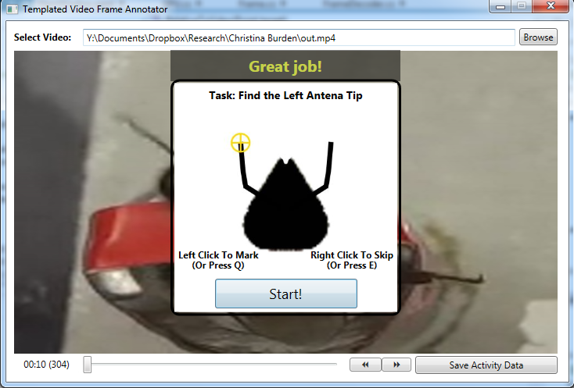
Templated Video Frame Annotator

Slide 9
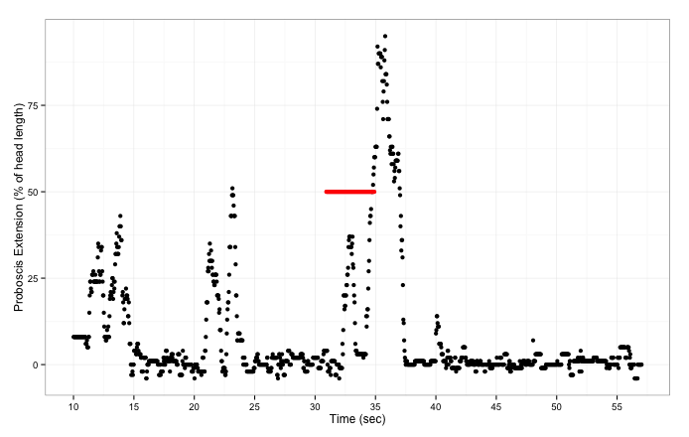
Proboscis Extension Response

Slide 10
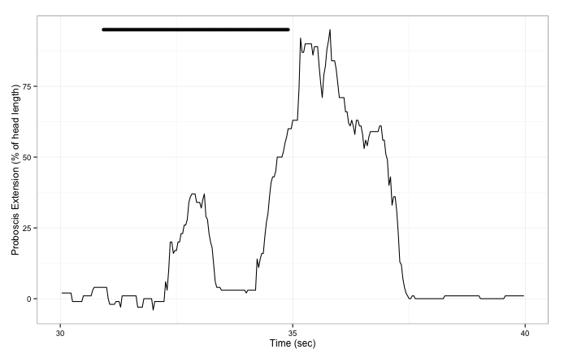
PER Expanded
ODOR ON
PER2 Intensity
Response Delay
PER2 Duration
PER1 Duration

Slide 11
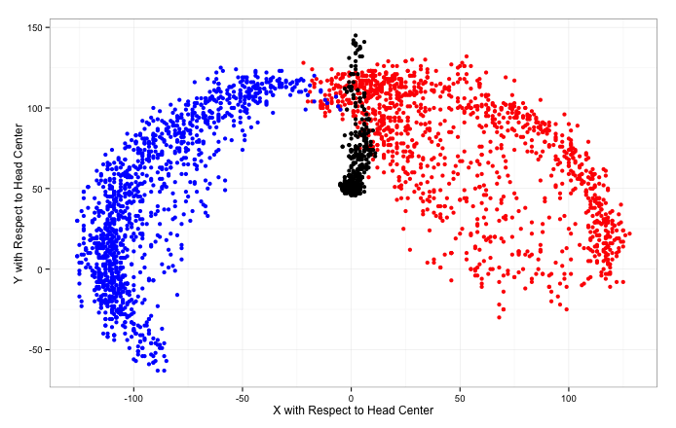
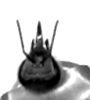
Antennae Movement

Slide 12
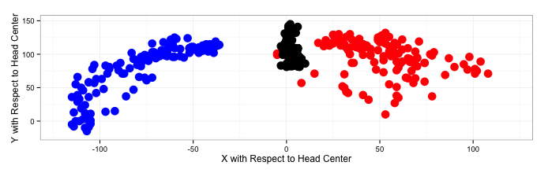
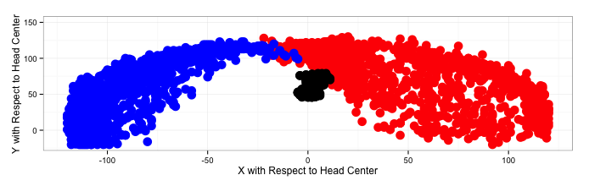
PER vs. Antenna Movement
PER
NO PER

Slide 13
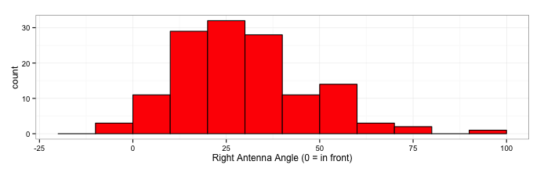
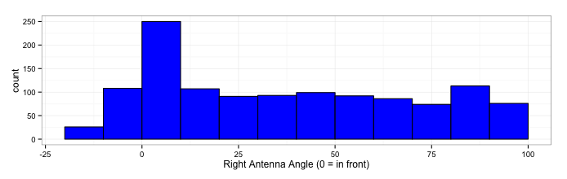
Right Antenna Angle During PER
PER
NO PER

Slide 14
SwarmSight
Download at:
github.com/JustasB/SwarmSight
Annotator
Email:
justas@asu.edu

